Slide 1
Lecture-12
Analysis and Synthesis of Pole-Zero Speech Models

Slide 2
Speech Production Model
H(z)=G(z)V(z)R(z)
A_{v}
Impulse
Train
Generator
Glottal
Pulse
G(z)
Vocal Track
Parameters
Voiced Sound
u_{G}[n]
Vocal Track
V(z)
u_{L}[n]
Lip
Radiation
R(z)
p_{L}[n]
Unvoiced Sound
Random
Noise
Generator
A_{N}
H(z)

Slide 3
Speech Production Model
H(z)=G(z)V(z)R(z)

Slide 4
All pole modeling
H(z)=G(z)V(z)R(z)

Slide 5
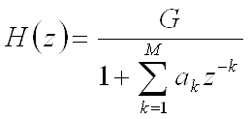
General Speech model:
Pitch period, P
Sometimes neglected
Gain (G)
Voiced/unvoiced switch
DT Impulse generator
G(z) Glottal filter
⊗
Voiced
u(n) Voice volume velocity
V
H(z) Vocal tract filter
R(z) Lip radiation filter
s(n) Speech signal
Uncorrelated noise generator
U
Unvoiced
⊗
Gain (G)

Slide 6
The LPC Model

Slide 7
Liner predictor
FIR Filter of order P
The prediction error:
P(z)
-

Slide 8
Error transfer function:

Slide 9
LP Estimation Issues
Need to determine {α_{k}} directly from speech such that they give good estimates of the time-varying spectrum
Need to estimate {α_{k}} from short segments of speech
Need to minimize mean-squared prediction error over short segments of speech
resulting {α_{k}} assumed to be the actual {a_{k}} in the speech production model
all of this can be done efficiently, reliably, and accurately for speech

Slide 10
Solution for {α_{k}}
mean squared error signal:

Slide 11
Can find values of α_{k} that minimize by setting
Where

Slide 12
leading to a set of p equations in p unknowns that can solved in an efficient manner for the {α_{k}}

Slide 13
The resulting covariance matrix is symmetric, but not Toeplitz, and can be solved efficiently by a set of techniques called Cholesky decomposition

Slide 14
Minimum mean-squared prediction error can be written as

Slide 15
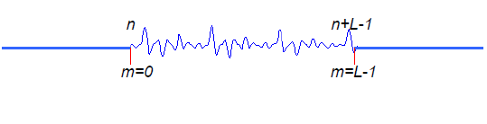
Autocorrelation Method
Let exists for 0 ≤ m ≤ L −1 and is exactly zero every where else (i.e., window of length samples)
Where w[m] is a finite length window of L samples

Slide 16
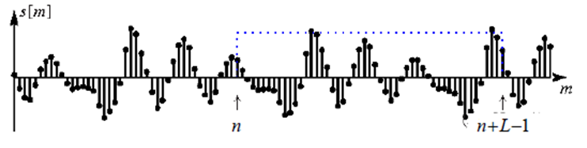
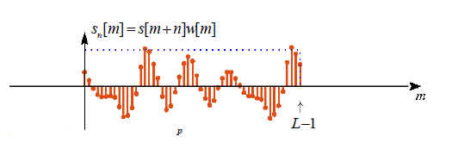
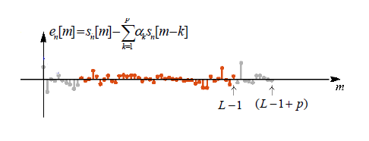

Slide 17
Is only non zero over the interval

Slide 19
There are L-| i-k| non-zero terms in the computation of for each value of i,k
Then
short-time autocorrelation
From equation (2)
Minimum mean-squared prediction error can be written as

Slide 20
is a pxp Toeplitz Matrix => symmetric with all diagonal elements equal
matrix equation solved using Levinson or Durbin method

Slide 21
The set of optimum predictor coefficients satisfy
with minimum mean-squared prediction error of

Slide 22
Expanded matrix is still Toeplitz and It can be solved iteratively by incorporating new correlation value at each iteration and solving for next higher order predictor in terms of new correlation value and previous predictor
i^{th} order solution can be derived from (i-1)^{st} order solution
given α^{(i-1)}, the solution to
we derive solution to

Slide 23
The (i −1)^{st} solution can be expressed as:

Slide 24
Appending a 0 to vector α and multiplying by the matrix R_{n}^{(i)} gives

Slide 25
Toeplitz matrix has special symmetry we can reverse the order of the equations

Slide 26
Combine the two sets of matrices with a multiplicative factor k_{i}
Choose of γ^{(i-1)} so that vector on right has only a single non-zero entry, i.e
1

Slide 27
The first element of the right hand side vector is now
2
The k_{i} parameters are called Partial Correlation (PARCOR) coefficients
So the vector of order i^{th} predictor coefficients is

Slide 28
3
4
A. The final solution for order p is:
B. with prediction error
C. If we use normalized autocorrelation coefficients:
D. normalized prediction error

Slide 29
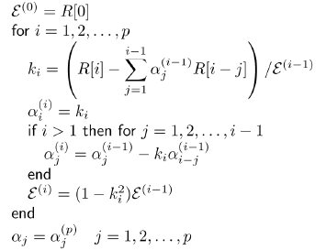

Slide 30
1. Consider a simple p = 2 find the solution
2. Consider a simple p = 3 find the solution
3. Consider a simple p = 4 find the solution

Slide 31
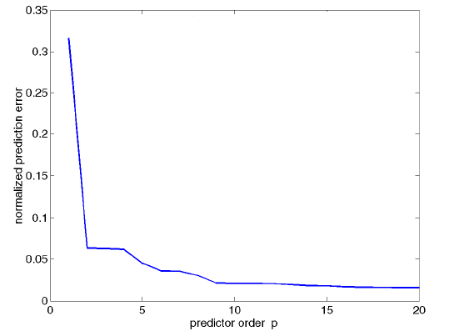
Prediction Error vs. Model Order
Model order is usually determined by:
Fs/1000 poles for vocal tract
2-4 poles for radiation
2 poles for glottal pulse

Slide 32
End

Slide 33
Lecture-13
Analysis and Synthesis of Pole-Zero Speech Models
Cont…

Slide 34
Computation of Model Gain
1
Put m=0 in equation (1)

Slide 35
Energy in h[m]=Energy in short time measurement s_{n}[m]
Solution for Gain (Voiced)

Slide 36
Solution for Gain (Unvoiced)
For unvoiced speech the input is white noise with zero mean and unity variance,
Excite the system with input Au[n]

Slide 38
Frequency Domain Interpretations of Linear Predictive Analysis
The final LPC model consists of the LPC parameters,α_{k} and gain A together which define the system function

Slide 39
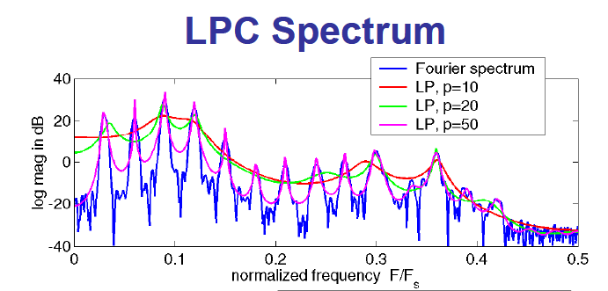

Slide 40
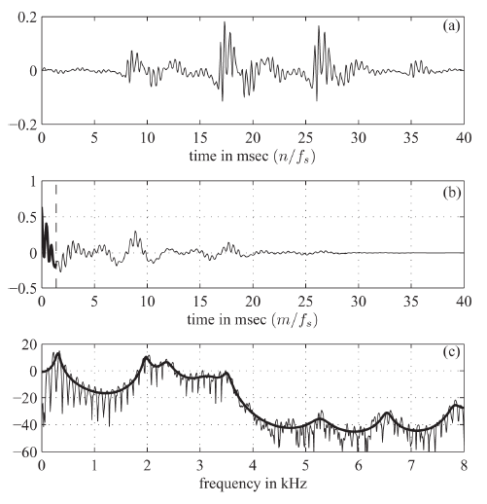

Slide 41
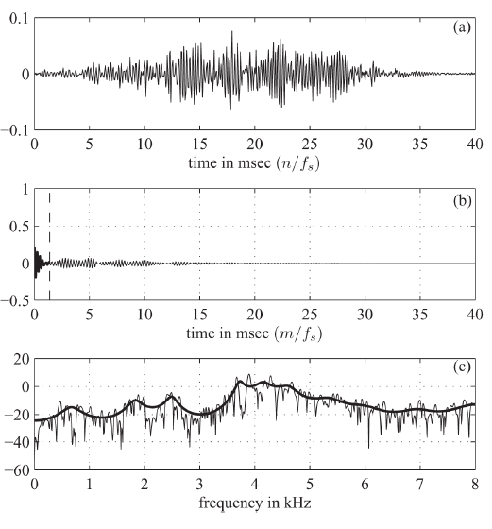

Slide 42
Effects of Model Order
The AC R_{n}[m] function of the speech segment S_{n}[m], and the AC function Rˆ_{n}[m], of the impulse response, corresponding to the system function h_{n}[m], are equal for the first ( p +1) values. As p->α the AC functions are equal for all values and thus:

Slide 43
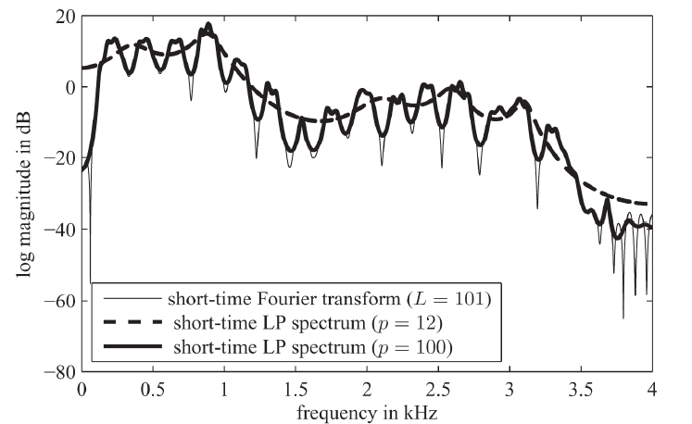

Slide 44
Linear Prediction Spectrogram
Speech spectrogram
LPC spectrogram

Slide 45
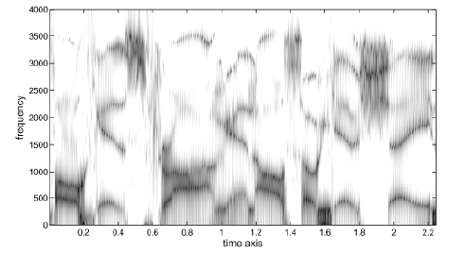

Slide 46
x
x
x
x
r
θ
x
o
-θ
x
x
x
x
x

Slide 47
Angle corresponds to frequency, and radius corresponds to bandwidth. So we can determine the pole (or resonant) frequencies and bandwidths (converting to Hz)

